Slide 1
MS4002D
INDUSTRIAL ECONOMICS
Rahul A Nair
Ad-hoc Faculty, SOMS, NITC
Email: rahulanair_adhoc@nitc.ac.in
Phone: 9074867268

Slide 2
PPT - 1
Introduction to
Industrial Economics
Introduction,
About the Conduct of the Course & Evaluation

Slide 3
How this course will be delivered
Total Hours = 39 hours
Go through the previous day’s material and the scheduled reading before coming to class
Exams (75%)
End-semester exam: 50 marks
Mid-term exam: 25 marks
Classroom learning will go beyond the textbook, so read widely
Assignment and Quiz (25%)
Assignment: 10 marks
3 Modules
Quiz: 15 marks
Relative Grading Policy

Slide 4

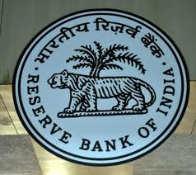
Economics & business management
Economic policy objective
Sustained growth in GDP
Price stability
Macroeconomic policy tools
Fiscal policy
Monetary policy
Government expenditure, taxes
Policy rates, Liquidity
Demand, Inflation, Costs, Interest rates, Exchange rates, Wages etc.
Households
Economic Environment
BUSINESS MANAGEMENT
Firms

Slide 5
What is this course about?
Micro & Macro economic theory
Current issues of the Indian economy
Industrial Economics

Slide 6
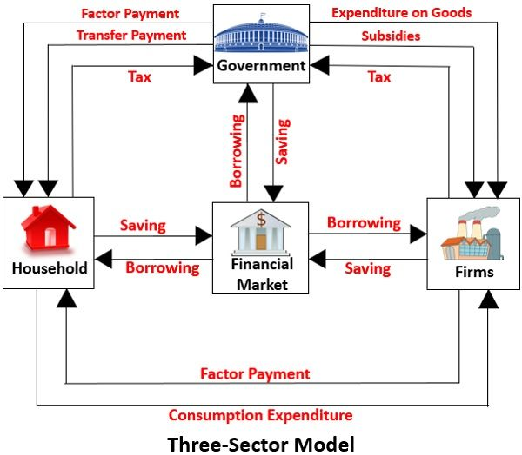
Circular flow of income

Slide 7


Why Microeconomics is important
How Parsis are coping up with the problem of extinction?
Why everybody in China are purchasing increasingly bigger house over time?

Slide 8

Why Microeconomics is important
How many kilograms of tomato I need to buy?
How many Fortuners need to be produced by Toyota?
How much Indigo has to charge for flight ticket?

Slide 9
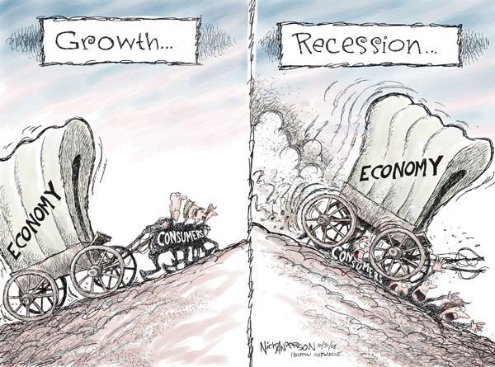
Contemporary issues in Macroeconomics
Macroeconomics, the study of the economy as a whole, addresses many topical issues
What government policies might help to bring a country out of a recession?
What is the implication of periodically released GDP, IIP, CPI etc. data?
How do the union budget announcements affect output & employment?
What is the impact of monetary policy decisions on the economy & businesses?

Slide 10

Contemporary issues in Macroeconomics
Macroeconomics, the study of the economy as a whole, addresses many topical issues
Why are some countries rich & others poor?
Can the poor countries catch up with the rich countries?
What policies can make India a developed nation?

Slide 11
Why do engineers require Economics
Understanding the decision making: scarcity of resources and opportunity cost
Understanding government policies: Decoding fiscal policy
Anticipate RBI move: Decoding Monetary policy
Inflation and currency movements
Anticipate business cycles
Understanding medium-term and long-term trends of economies
All the above is required for a Manager to make an informed decision on various domains

Slide 12

Why should you care?
Finance: equity analysis, banking
HR: learning & development, performance management
IT & Systems: product management, business analysis
Marketing: product marketing, market research
Operations: project management, SCM
Strategy: business planning, consulting
Entrepreneurship

Slide 13
Course Contents
Session | Module | Topic
1 | Introduction to Industrial Economics | General foundation: scarcity of resources and opportunity cost
2-9 | Foundation of economics | Circular flow of income, consumer choice, demand and supply analysis, elasticity of demand
10-16 | Production and cost | Production function, Short-run vs long-run, economies of scale
17-21 | Market structure | Structure, Conduct, Performance Competitive market, Market imperfections, equilibrium in the markets

Slide 14
Course Contents (contd..)
Session | Module | Topic
22-23 | Pricing, Oligopoly | Price discrimination, degrees of price discrimination, consumer surplus and dead- weight loss
24-28 | Game theory | Prisoners Dilemma and Nash equilibrium
29-33 | National income accounting and cost of living | Measurement of GDP, Real Versus Nominal GDP, Limitations of GDP, CPI, WPI, Purchasing Power Parity, Unemployment
34-39 | Financial Market, Financial ratios | Role of RBI, Monetary Policy Transmission, Tackling Inflation, Financial institutions, Financial markets, Ratios, Depreciation

Slide 15
Resources for the course
Textbooks for reference:
  R. S. Pindyck, D. L. Rubinfield and P. L. Mehta, Microeconomics, Pearson Education, 9th Edition, 2018.
  P. A. Samuelson and W. D. Nordhaus,Economics, Tata McGraw Hill, 19th ed., 2015.
  N. G. Mankiw, Principles of Microeconomics, Cengage Publications, 7th ed., 2014.
  S. B. Gupta, Monetary Economics: Institutions, Theory & Policy, New Delhi: S. Chand & Company Ltd., 2013.
  K. E. Case, R. C. Fair and S. Oster, Principles of Economics, Prentice Hall, 10th ed., 2011.
Slides of the lecture
Supplementary materials would be suggested for selected topics on financial markets and Indian economy.

Slide 16
How to gain from this course
Please read the reference text book before coming to class.
Then, go through the lecture slides.
Start reading Economic Times, Business Line, Financial Times, Livemint, Blogs (integrating Macro with Business & Markets)
Listen to CNBC discussion called “Indianomics’’, Bloomberg Quint videos

Slide 17
Main Topics
Pre mid-sem
Demand & Supply
Consumer Choice
Production theory
Technology & Costs
Post mid-sem
Market structure: competitive and imperfect markets
Price discrimination
Game Theory and Oligopoly
Measurement of GDP
Fiscal policy
Monetary policy

